Slide 1
PSCS_531_Projection of the extent of inundation corresponding to the forecasts of flood levels in a river.
CSE7101- Capstone Project
Review-2
Batch Number: CSE_131
Roll Number | Student Name
HARSHITHA A Y | 20221CSE0526
HAMSA M | 20221CSE0525
BHAGYASHREE N PATIL | 20221CSE0499
Under the Supervision of,
Mr.Likhith S.R
Professor-School of Computer Science and Engineering
Presidency University
Name of the Program: CSE
Name of the HoD: Dr. Asif Mohamed H B
Name of the Program Project Coordinator: Dr. Jayavadivel Ravi
Name of the School Project Coordinators: Dr. Sampath A K , Dr. Geetha A

Slide 2
Content
Problem Statement
Abstract
Literature Survey
Objectives
Existing Methods and Drawbacks
Proposed Methods and Feasibility Study
Architecture Diagram
Modules
Hardware and Software Details
Timeline of the Project (Gantt Chart)
References

Slide 3
Problem Statement Number: PSCS
Organization : Department of Computer Science and Engineering,
Presidency University Bangalore
Category (Hardware / Software / Both) : Software
Problem Description:
Floods are one of the most destructive natural disasters, causing loss of lives, damage to infrastructure, and economic setbacks. Traditional prediction methods often lack accuracy and timeliness. This project uses machine learning with multi-source data—rainfall, river levels, temperature, and satellite imagery—to provide accurate, real-time flood forecasts for better preparedness and response.

Slide 4
Abstract
This project focuses on Flood Prediction Using Satellite Imagery and Machine Learning, with the primary goal of developing robust backend models. Key environmental parameters such as rainfall intensity, soil moisture, water body size, and topographical variations are extracted from satellite imagery to train models like K-Means, XGBoost, and Decision Trees. Extensive experimentation and analysis are conducted, comparing models using standard accuracy metrics and data visualizations to capture trends and patterns. The backend system ensures scalability and reliability, enabling accurate predictions that can later be integrated into larger flood monitoring and early-warning systems. This contributes to reducing the impact of floods on human lives, infrastructure, and the environment.

Slide 5
Literature Survey
Sources: IEEE
Focus: Identify strengths, limitations, and research gaps to guide our project design.
Author / Year | Title | Overall Accuracy | Dataset
M. Thomas, 2012 | A Framework to Assess Remote Sensing Algorithms for Satellite-Based Flood Index Insurance | 71% – 95% | Landsat TM imagery, field survey data, aerial photography.
S. H. Mahir, 2025 | Advanced Hydro-Informatic Modeling Through Feedforward Neural Network, Federated Learning, and Explainable AI for Enhancing Flood Prediction | Achieved ~95% prediction accuracy for flood forecasting | Hydrological & meteorological datasets (rainfall, water levels, flow data from multiple regions)
Y. Liu, L. Wang, S. Du, L. Zhao and X. Liu, 2023 | Flood Forecasting Method Based on Improved VMD-FOS-QR-RBL | Achieved prediction accuracy above 93% | Hydrological time series data (river flow & rainfall) from flood-prone regions in China
J. Du , 2020 | Satellite Flood Assessment and Forecasts from SMAP and Landsat | Reported ~90% accuracy in flood extent mapping and forecasting. | Satellite imagery (SAR & optical) + hydrological observations from flood-prone river basins
Y. Djenouri, M. Godziszewski, F. Andrade, G. Srivastava, A. N. Belbachir and A. Murano, 2024 | Game-Theoretic Consensus Deep Learning for Adaptive Flood Prediction in Digital Twin Environments | Achieved >94% forecasting accuracy | Multi-source hydrological datasets (rainfall, discharge, water levels) from flood prone regions
Author / Year | Title | Contribution | Relevance to Our Work
Singh, 2023 | Digital Grievance Redressal Systems: Improving Transparency | Emphasized accountability & citizen trust | Motivates “Reopen & Audit Trail” feature
Lee & Patel, 2022 | Cross-Platform Mobile App Development Using Flutter | Showed efficiency of Flutter for cross-platform apps | Supports our Flutter mobile app
Sharma, 2021 | E-Governance and Citizen Engagement | Highlighted importance of user-friendly portals | Justifies our UI/UX improvements
Cortés-Cediel, 2023 | Trends & Challenges of E-Government Chatbots | Reviewed chatbots in e-gov, stressed multilingual needs | Supports AI chatbot in Kannada/English
Gupta, 2025 | AI-Based Solution for Grievance Lodging | Proposed multilingual AI chatbot system | Guides our AI/ML chatbot integration

Slide 6
Literature Survey
Author / Year | Title | Overall Accuracy | Dataset
N. Akhtar, 2019 | Hierarchical Coloured Petri-Net Based Multi-Agent System for Flood Monitoring, Prediction, and Rescue (FMPR) | Reported ~88% forecasting accuracy | Hydrological datasets (rainfall, river discharge, water levels) from case-study river basins.
Z. Jiao, B. Chen, Z. Zhang and L. Wu, 2021 | Sample-Adjusted Threshold Calculation (SATC) for Optimizing Flood Mapping From a Trustworthy and Explainable Perspective | Reported ~91% forecasting accuracy | Hydrological datasets (rainfall & river flow) from multiple flood affected regions
P. Yang, X. Xu, M. Shao and Y. Liu, 2024 | Intelligent Prediction of Flood Disaster Risk Levels Based on Knowledge Graph and Graph Neural Networks | The GNN-Risk model achieved an accuracy of 89%. | 9,000 records of mountain flood disaster data from Jiangxi Province. The data includes geographical location, risk type, and historical events.
S. Puttinaovarat and P. Horkaew, 2020 | Flood Forecasting System Based on Integrated Big and Crowdsource Data by Using Machine Learning Techniques | MLP ANN, with a correct percentage of 97.83% and a Kappa value of 0.89. The MAE was 0.01 and RMSE was 0.10 | Meteorological, hydrological, geospatial, and crowdsource data from two provinces in Thailand
D. H. Nguyen, X. Hien Le, J. -Y. Heo and D. -H. Bae, 2021 | Development of an Extreme Gradient Boosting Model Integrated With Evolutionary Algorithms for Hourly Water Level Prediction | Relative error (MAPE) ranged from 2.18% to 9.21% | Hourly rainfall and water level data from 2003 to 2020 for the Jungrang urban basin in South Korea

Slide 7
Objectives
To collect and preprocess diverse flood-related datasets, including rainfall, river water levels,temperature, and historical flood records.
To analyse and evaluate model performance based on accuracy, precision, and recall to determine the most effective approach.
To develop a real-time flood forecasting system capable of providing early warnings for high-risk areas.
To implement and compare multiple machine learning models (e.g. K-means, XGBoost) for flood prediction.

Slide 8
Existing Methods and Drawbacks
Existing Applications Studied:
Janaspandana, iPGRS, Namma Bengaluru, Grama One, Karnataka One, Sakala.
Key Drawbacks:
Poor connectivity in rural areas
No search bar or voice search functionality.
No voice-to-text for complaint descriptions.
Image upload issues: Restrictive 5MB limit, no delete/cancel option.
No 'reopen' option for unresolved complaints.
Technical glitches and frequent downtime.
Lack of integration with helplines like 1902.
Absence of AI/chatbot support.

Slide 9
Proposed Methods & Feasibility
Innovations & Solutions:
Voice-to-text support (AI/ML-based) for complaint descriptions.
Smart search bar with mic for multilingual queries.
Improved image upload with compression and a delete option.
Reopen grievance option for transparency and accountability.
1902 Helpline integration and a call-back request feature.
AI Chatbot for instant assistance.
Feasibility:
Cost Feasibility: Uses open-source libraries (Python, Scikit-learn, XGBoost) → no license cost.
Technical Feasibility: Leverages proven and modern frameworks (React, Flutter, Node.js).
Resource Feasibility: Supports both web and mobile platforms and is cloud-deployable.

Slide 10
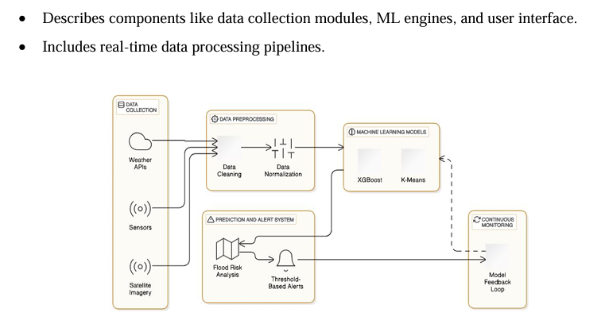
Architecture Diagram

Slide 11
Modules
User Module: Register, Login, Submit grievance (with voice input), Upload/delete images, Track status, Reopen complaint.
Admin Module: Assign grievances, Update/close status, Approve reopen requests, View dashboard analytics.
Chatbot Module: AI-based assistant for FAQs and general guidance.
Helpline Module: 1902 integration with call-back request handling.
Notification Module: Real-time push notifications to users and admins.

Slide 12
Hardware and Software
Software
OS: Windows/Linux/MacOS
Programming Language: Python 3.8+
Key Libraries:
Machine Learning: xgboost, scikit-learn
Data Processing: pandas, numpy
Visualization: matplotlib, seaborn
APIs: requests
Assumptions:
• APIs (e.g., OpenWeather) are active and accessible.
•The dataset is clean and representative of real-world scenarios.
• Necessary permissions to access satellite data are in place.
Hardware:
High-performance servers
GPUs for ML models.

Slide 13
Github Link
The Github link provided should have public access permission.
Github Link
https://github.com/harshitha101831/Batch-number_131/upload

Slide 14
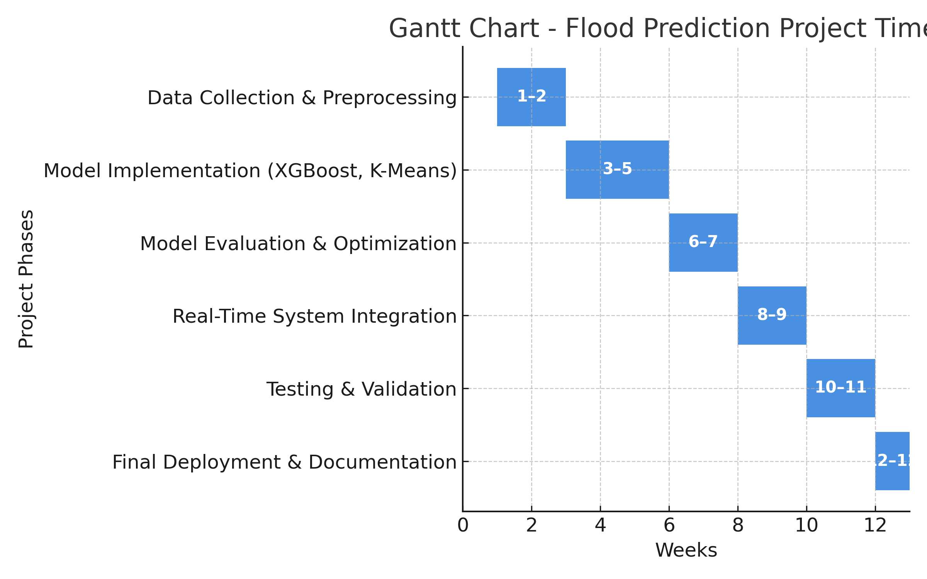
Timeline of the Project (Gantt Chart)

Slide 15
References (IEEE Paper format)
  .
[[1] M. Thomas et al., "A Framework to Assess Remote Sensing Algorithms for Satellite-Based Flood Index Insurance," in IEEE Journal of Selected Topics in Applied Earth Observations and Remote Sensing, vol. 16, pp. 2589-2604, 2023, doi: 10.1109/JSTARS.2023.3244098.
[2] S. H. Mahir et al., "Advanced Hydro-Informatic Modeling Through Feedforward Neural Network, Federated Learning, and Explainable AI for Enhancing Flood Prediction," in IEEE Open Journal of the Computer Society, vol. 6, pp. 726-738, 2025, doi: 10.1109/OJCS.2025.3556424.
[3]Y. Liu, L. Wang, S. Du, L. Zhao and X. Liu, "Flood Forecasting Method Based on Improved VMD-FOS-QR-RBL," in IEEE Access, vol. 11, pp. 4207-4218, 2023, doi: 10.1109/ACCESS.2022.3232405.
[4] J. Du et al., "Satellite Flood Assessment and Forecasts from SMAP and Landsat," IGARSS 2020 - 2020 IEEE International Geoscience and Remote Sensing Symposium, Waikoloa, HI, USA, 2020, pp. 3334-3337, doi: 10.1109/IGARSS39084.2020.9323552

Slide 16
[5] Y. Djenouri, M. Godziszewski, F. Andrade, G. Srivastava, A. N. Belbachir and A. Murano, "Game-Theoretic Consensus Deep Learning for Adaptive Flood Prediction in Digital Twin Environments," in IEEE Journal of Selected Topics in Applied Earth Observations and Remote Sensing, doi: 10.1109/JSTARS.2025.3596008.
[6]N. Akhtar et al., "Hierarchical Coloured Petri-Net Based Multi-Agent System for Flood Monitoring, Prediction, and Rescue (FMPR)," in IEEE Access, vol. 7, pp. 180544-180557, 2019, doi: 10.1109/ACCESS.2019.2958258.
[7] Z. Jiao, B. Chen, Z. Zhang and L. Wu, "Sample-Adjusted Threshold Calculation (SATC) for Optimizing Flood Mapping From a Trustworthy and Explainable Perspective," in IEEE Journal of Selected Topics in Applied Earth Observations and Remote Sensing, vol. 18, pp. 13622-13634, 2025, doi: 10.1109/JSTARS.2025.3572055

Slide 17
[8] P. Yang, X. Xu, M. Shao and Y. Liu, "Intelligent Prediction of Flood Disaster Risk Levels Based on Knowledge Graph and Graph Neural Networks," in IEEE Access, vol. 13, pp. 8416-8424, 2025, doi: 10.1109/ACCESS.2025.3525757.
[9] S. Puttinaovarat and P. Horkaew, "Flood Forecasting System Based on Integrated Big and Crowdsource Data by Using Machine Learning Techniques," in IEEE Access, vol. 8, pp. 5885-5905, 2020, doi: 10.1109/ACCESS.2019.2963819.
[10] D. H. Nguyen, X. Hien Le, J. -Y. Heo and D. -H. Bae, "Development of an Extreme Gradient Boosting Model Integrated With Evolutionary Algorithms for Hourly Water Level Prediction," in IEEE Access, vol. 9, pp. 125853-125867, 2021, doi: 10.1109/ACCESS.2021.3111287.

Slide 18


